Slide 1
Concurso Kaggle
Yolov5 (paso a paso)

Slide 2
1-Yolo v5 - https://www.kaggle.com/ultralytics/yolov5
**YOLO (You Only Look Once)** is a clever convolutional neural network (CNN) for doing object detection in real-time. The algorithm applies a single neural network to the full image, and then divides the image into regions and predicts bounding boxes and probabilities for each region. These bounding boxes are weighted by the predicted probabilities.

Slide 3
2-Versiones Yolo importantes y links documentación
YOLOv5
Shortly after the release of YOLOv4 Glenn Jocher introduced YOLOv5 using the Pytorch framework. The open source code is available on GitHub
Author: Glenn Jocher Released: 18 May 2020 https://github.com/ultralytics/yolov5
YOLOv4
With the original authors work on YOLO coming to a standstill, YOLOv4 was released by Alexey Bochoknovskiy, Chien-Yao Wang, and Hong-Yuan Mark Liao. The paper was titled YOLOv4: Optimal Speed and Accuracy of Object Detection
Author: Alexey Bochoknovskiy, Chien-Yao Wang, and Hong-Yuan Mark Liao Released: 23 April 2020 Yolov4 https://arxiv.org/abs/2004.10934v1

Slide 4
3- https://www.kaggle.com/ultralytics/yolov5
Version 14 of 14
Notebook
Setup1.
Inference2.
Validate3.
Train4.
Visualize
Environments
Status
Appendix
Input (1)
Execution
Info Log

Slide 5
4 - Yolov5 en Kaggle 1: Setup
Clone repo, install dependencies and check PyTorch and GPU.
!git clone https://github.com/ultralytics/yolov5 # clone repo
%cd yolov5
%pip install -qr requirements.txt # install dependencies
import torch
from IPython.display import Image, clear_output # to display images
clear_output()
print(f"Setup complete. Using torch {torch.__version__} ({torch.cuda.get_device_properties(0).name if torch.cuda.is_available() else 'CPU'})")

Slide 6
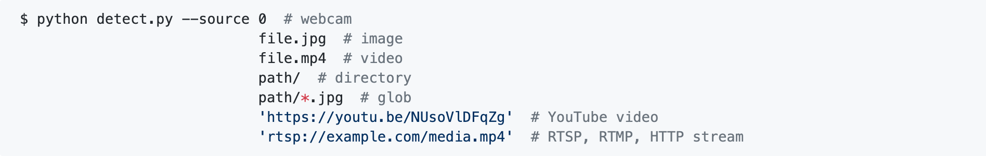
5 - yolov5 - 2. Inference
detect.py runs YOLOv5 inference on a variety of sources, downloading models automatically from the latest YOLOv5 release, and saving results to runs/detect
. Example inference sources are:
!python detect.py --weights yolov5s.pt --img 640 --conf 0.25 --source data/images/
Image(filename='runs/detect/exp/zidane.jpg', width=600)

Slide 7
5 - yolov5 - 2. Inference
detect: weights=['yolov5s.pt'], source=data/images/, imgsz=640, conf_thres=0.25, iou_thres=0.45, max_det=1000, device=, view_img=False, save_txt=False, save_conf=False, save_crop=False, nosave=False, classes=None, agnostic_nms=False, augment=False, visualize=False, update=False, project=runs/detect, name=exp, exist_ok=False, line_thickness=3, hide_labels=False, hide_conf=False, half=False
Downloading https://github.com/ultralytics/yolov5/releases/download/v5.0/yolov5s.pt to yolov5s.pt...
100%|███████████████████████████████████████| 14.1M/14.1M [00:00<00:00, 100MB/s]
image 1/2 /kaggle/working/yolov5/data/images/bus.jpg: 640x480 4 persons, 1 bus, 1 fire hydrant, Done. (0.043s)
image 2/2 /kaggle/working/yolov5/data/images/zidane.jpg: 384x640 2 persons, 2 ties, Done. (0.028s)
Results saved to runs/detect/exp
Done. (0.199s)

Slide 8
6- yolov5 - 3. Validate
Validate a model's accuracy on COCO val or test-dev datasets. Models are downloaded automatically from the latest YOLOv5 release. To show results by class use the --verbose flag. Note that pycocotools metrics may be ~1% better than the equivalent repo metrics, as is visible below, due to slight differences in mAP computation.
COCO val2017
Download COCO val 2017 dataset (1GB - 5000 images), and test model accuracy.
# Download COCO val2017
torch.hub.download_url_to_file('https://github.com/ultralytics/yolov5/releases/download/v1.0/coco2017val.zip', 'tmp.zip')
!unzip -q tmp.zip -d ../datasets && rm tmp.zip
# Run YOLOv5x on COCO val2017
!python val.py --weights yolov5x.pt --data coco.yaml --img 640 --iou 0.65 --half

Slide 9
6- yolov5 - 3. Validate
val: data=./data/coco.yaml, weights=['yolov5x.pt'], batch_size=32, imgsz=640, conf_thres=0.001, iou_thres=0.65, task=val, device=, single_cls=False, augment=False, verbose=False, save_txt=False, save_hybrid=False, save_conf=False, save_json=True, project=runs/val, name=exp, exist_ok=False, half=True
Downloading https://github.com/ultralytics/yolov5/releases/download/v5.0/yolov5x.pt to yolov5x.pt...
100%|████████████████████████████████████████| 168M/168M [00:02<00:00, 81.6MB/s]
val: Scanning '../datasets/coco/val2017' images and labels...4952 found, 48 miss
Class Images Labels P R mAP@.5 mAP@val.py:61: UserWarning: This overload of nonzero is deprecated:
nonzero()
Consider using one of the following signatures instead:
nonzero(*, bool as_tuple) (Triggered internally at /opt/conda/conda-bld/pytorch_1603729047590/work/torch/csrc/utils/python_arg_parser.cpp:882.)
ti = (cls == tcls).nonzero().view(-1) # label indices
Class Images Labels P R mAP@.5 mAP@

Slide 10
7- yolov5 - 4. COCO test-dev2017
Download COCO test2017 dataset (7GB - 40,000 images), to test model accuracy on test-dev set (20,000 images, no labels). Results are saved to a *.json file which should be zipped and submitted to the evaluation server at https://competitions.codalab.org/competitions/20794.
# Download COCO test-dev2017
torch.hub.download_url_to_file('https://github.com/ultralytics/yolov5/releases/download/v1.0/coco2017labels.zip', 'tmp.zip')
!unzip -q tmp.zip -d ../ && rm tmp.zip # unzip labels
!f="test2017.zip" && curl http://images.cocodataset.org/zips/$f -o $f && unzip -q $f && rm $f # 7GB, 41k images
%mv ./test2017 ../coco/images # move to /coco
# Run YOLOv5s on COCO test-dev2017 using --task test
!python val.py --weights yolov5s.pt --data coco.yaml --task test
https://github.com/ultralytics/yolov5/wiki/Train-Custom-Data

Slide 11
7- yolov5 - 4. COCO test-dev2017
https://github.com/ultralytics/yolov5/wiki/Train-Custom-Data
Train On Custom Data
1. Create dataset.yaml
COCO128 is an example small tutorial dataset composed of the first 128 images in COCO train2017. These same 128 images are used for both training and validation to verify our training pipeline is capable of overfitting. data/coco128.yaml, shown below, is the dataset config file that defines 1) the dataset root directory path and relative paths to train / val / test image directories (or *.txt files with image paths), 2) the number of classes nc and 3) a list of class names:
# Train/val/test sets as 1) dir: path/to/imgs, 2) file: path/to/imgs.txt, or 3) list: [path/to/imgs1, path/to/imgs2, ..]
path: ../datasets/coco128 # dataset root dir
train: images/train2017 # train images (relative to 'path') 128 images
val: images/train2017 # val images (relative to 'path') 128 images
test: # test images (optional)
# Classes
nc: 80 # number of classes
names: [ 'person', 'bicycle', 'car', 'motorcycle', 'airplane', 'bus', 'train', 'truck', 'boat', 'traffic light',
'fire hydrant', 'stop sign', 'parking meter', 'bench', 'bird', 'cat', 'dog', 'horse', 'sheep', 'cow',
'elephant', 'bear', 'zebra', 'giraffe', 'backpack', 'umbrella', 'handbag', 'tie', 'suitcase', 'frisbee',
'skis', 'snowboard', 'sports ball', 'kite', 'baseball bat', 'baseball glove', 'skateboard', 'surfboard',
'tennis racket', 'bottle', 'wine glass', 'cup', 'fork', 'knife', 'spoon', 'bowl', 'banana', 'apple',
'sandwich', 'orange', 'broccoli', 'carrot', 'hot dog', 'pizza', 'donut', 'cake', 'chair', 'couch',
'potted plant', 'bed', 'dining table', 'toilet', 'tv', 'laptop', 'mouse', 'remote', 'keyboard', 'cell phone',
'microwave', 'oven', 'toaster', 'sink', 'refrigerator', 'book', 'clock', 'vase', 'scissors', 'teddy bear',
'hair drier', 'toothbrush' ] # class names

Slide 12
8- yolov5 - 5. Train
Download COCO128, a small 128-image tutorial dataset, start tensorboard and train YOLOv5s from a pretrained checkpoint for 3 epochs (note actual training is typically much longer, around 300-1000 epochs, depending on your dataset).
# Download COCO128
torch.hub.download_url_to_file('https://github.com/ultralytics/yolov5/releases/download/v1.0/coco128.zip', 'tmp.zip')
!unzip -q tmp.zip -d ../ && rm tmp.zip

Slide 13
9- yolov5 - 5. Train
Train a YOLOv5s model on COCO128 with --data coco128.yaml, starting from pretrained --weights yolov5s.pt, or from randomly initialized --weights '' --cfg yolov5s.yaml. Models are downloaded automatically from the latest YOLOv5 release, and COCO, COCO128, and VOC datasets are downloaded automatically on first use.
All training results are saved to runs/train/ with incrementing run directories, i.e. runs/train/exp2, runs/train/exp3 etc.

Slide 14
10- yolov5 - 5. Train
# Tensorboard (optional)
%load_ext tensorboard
%tensorboard --logdir runs/train
# Weights & Biases (optional)
%pip install -q wandb
import wandb
wandb.login()
# Train YOLOv5s on COCO128 for 3 epochs
!python train.py --img 640 --batch 16 --epochs 3 --data coco128.yaml --weights yolov5s.pt --cache

Slide 15
11- yolov5 - Weights & Biases Logging
Weights & Biases (W&B) is now integrated with YOLOv5 for real-time visualization and cloud logging of training runs. This allows for better run comparison and introspection, as well improved visibility and collaboration for teams. To enable W&B pip install wandb, and then train normally (you will be guided through setup on first use).
During training you will see live updates at https://wandb.ai/home, and you can create and share detailed Reports of your results. For more information see the YOLOv5 Weights & Biases Tutorial.

Slide 16
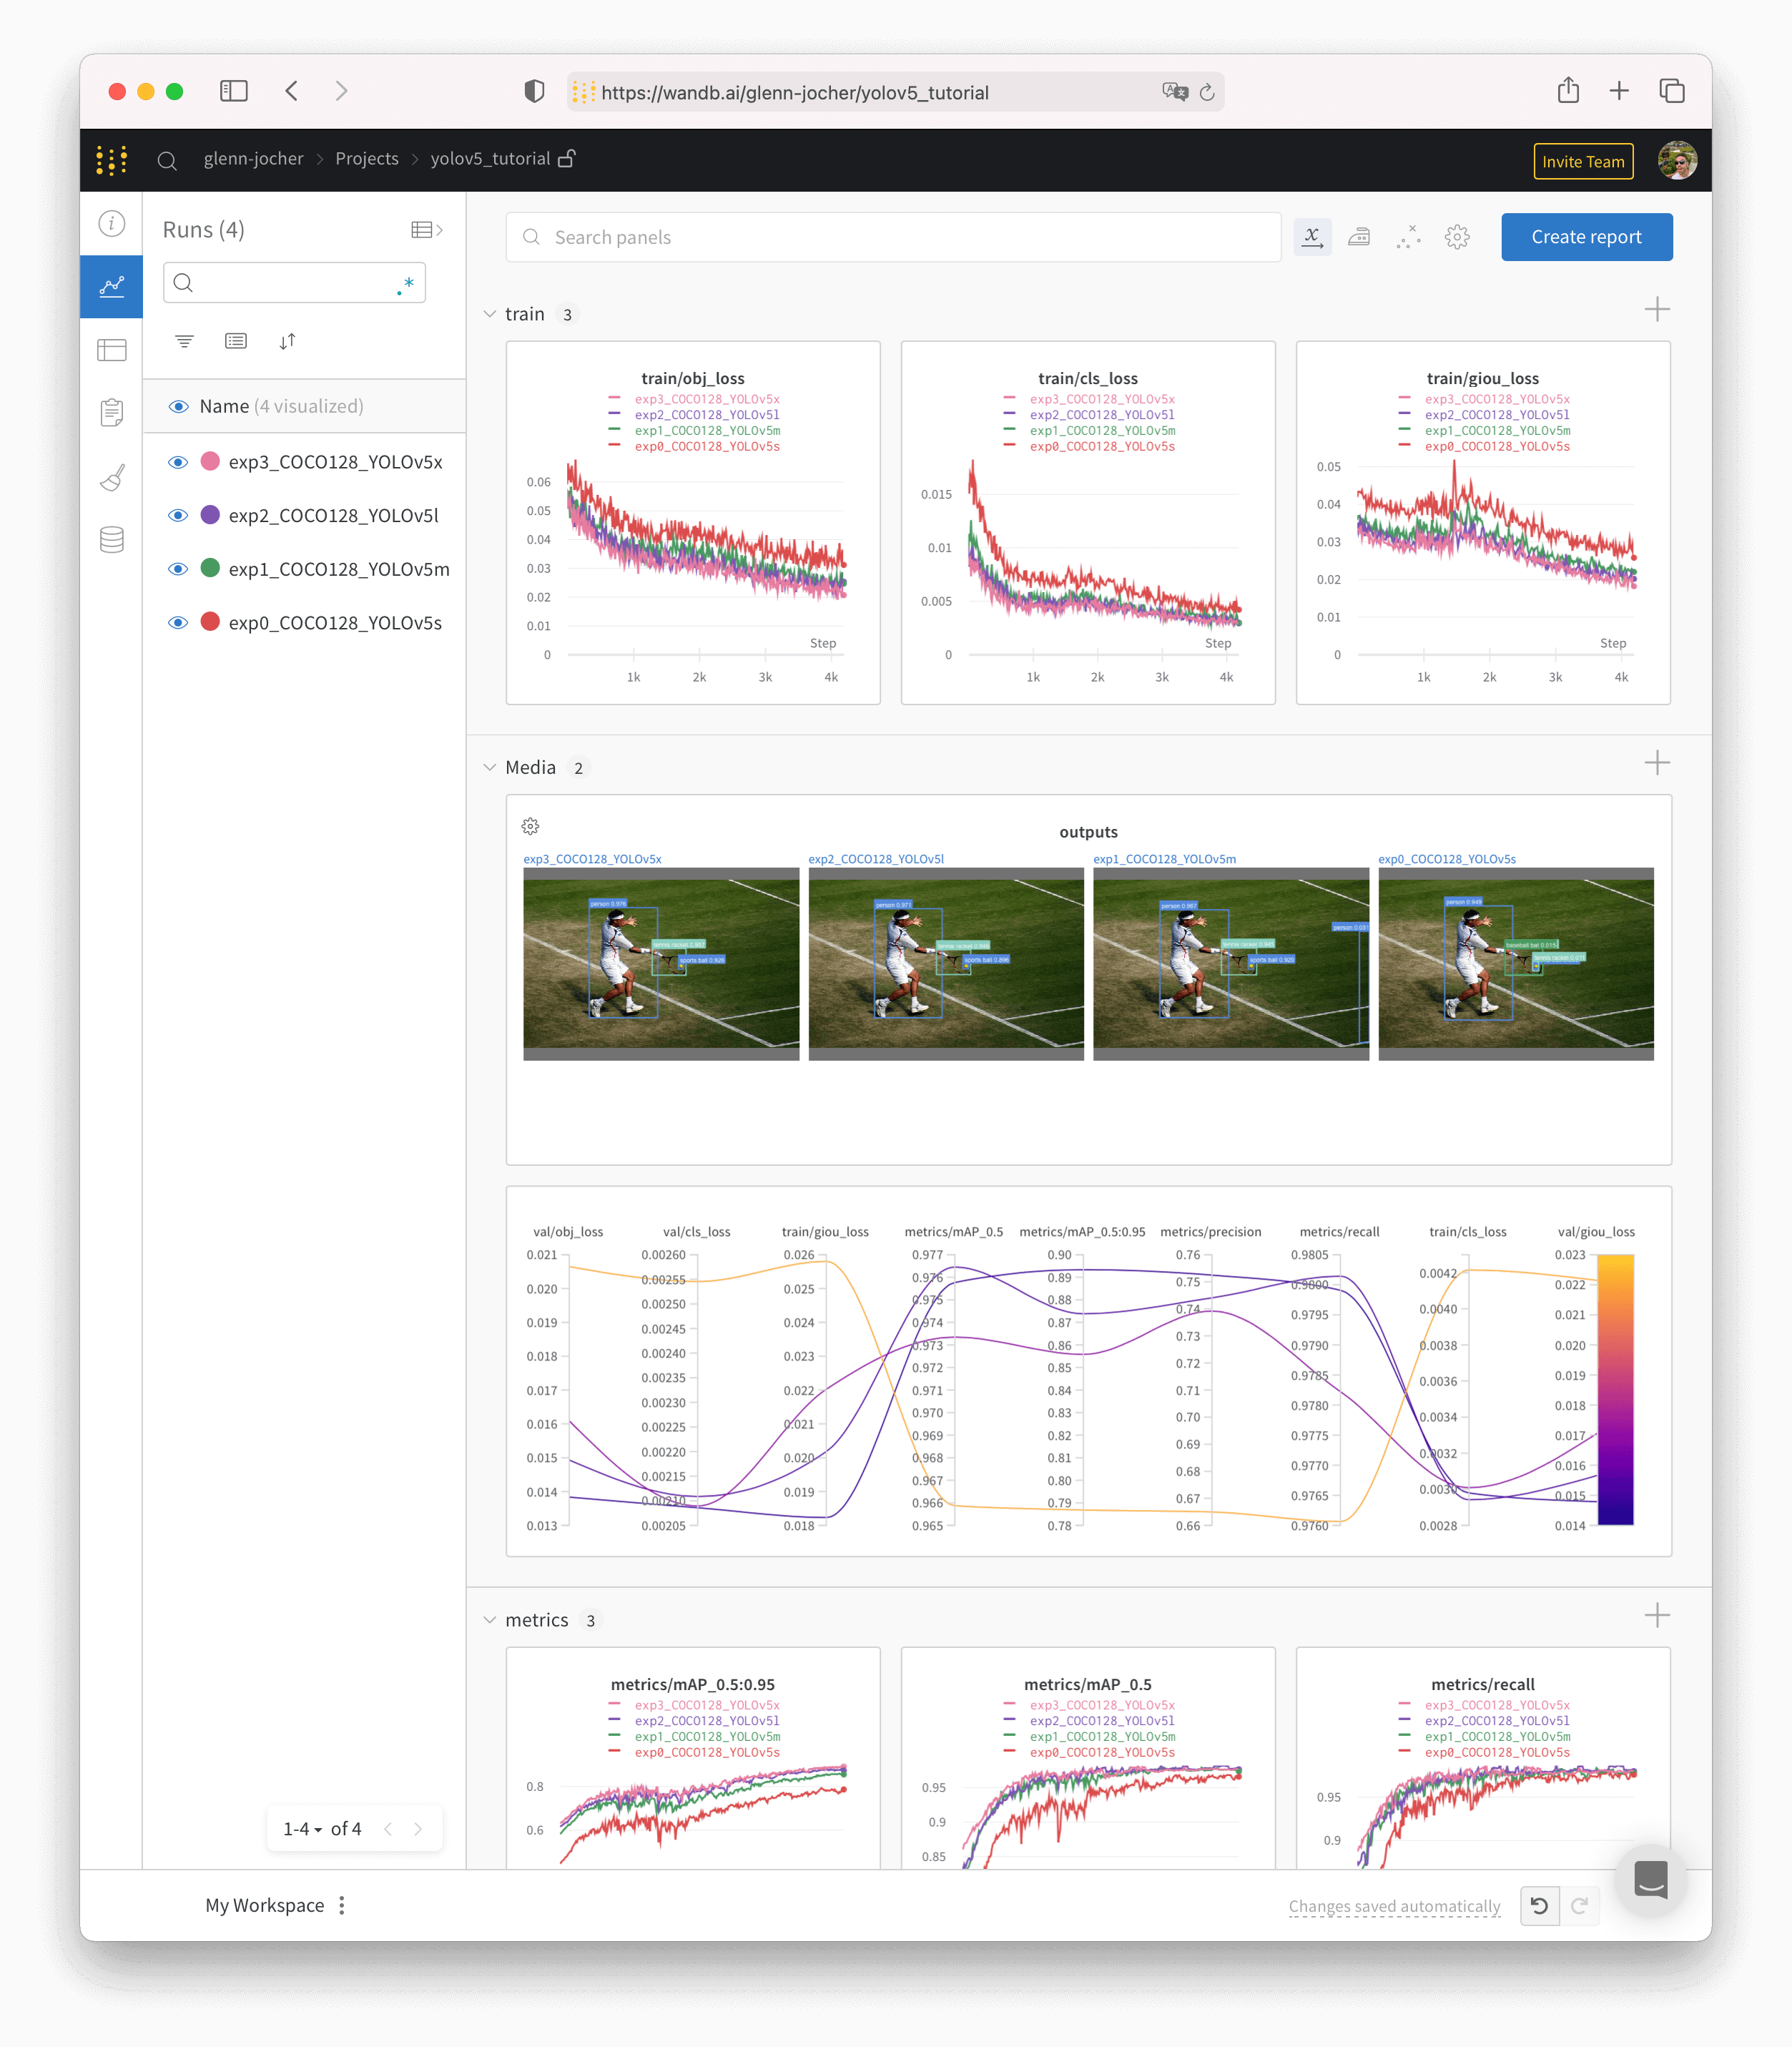
12- yolov5 - Weights & Biases Logging

Slide 17
13- yolov5 - Local Logging
Local Logging
All results are logged by default to runs/train, with a new experiment directory created for each new training as runs/train/exp2, runs/train/exp3, etc. View train and val jpgs to see mosaics, labels, predictions and augmentation effects. Note a Mosaic Dataloader is used for training (shown below), a new concept developed by Ultralytics and first featured in YOLOv4.
Image(filename='runs/train/exp/train_batch0.jpg', width=800) # train batch 0 mosaics and labels
Image(filename='runs/train/exp/test_batch0_labels.jpg', width=800) # val batch 0 labels
Image(filename='runs/train/exp/test_batch0_pred.jpg', width=800) # val batch 0 predictions

Slide 18
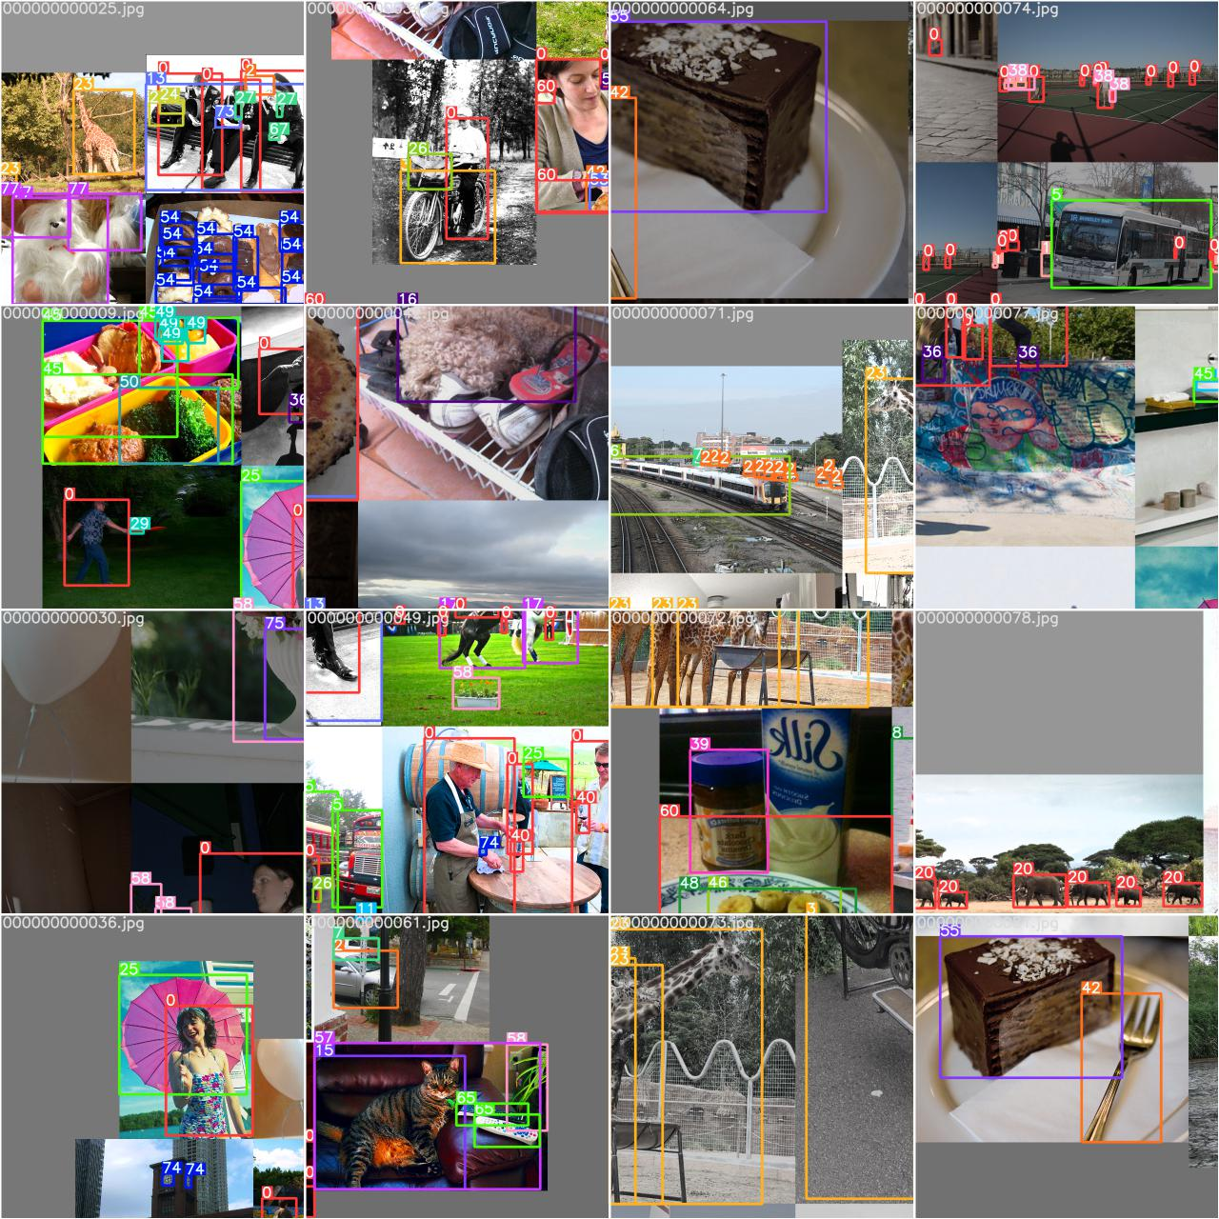
14- yolov5 - Mosaic Dataloader
Training results are automatically logged to Tensorboard and runs/train/exp/results.txt, which is plotted as results.png (below) after training completes.

Slide 19
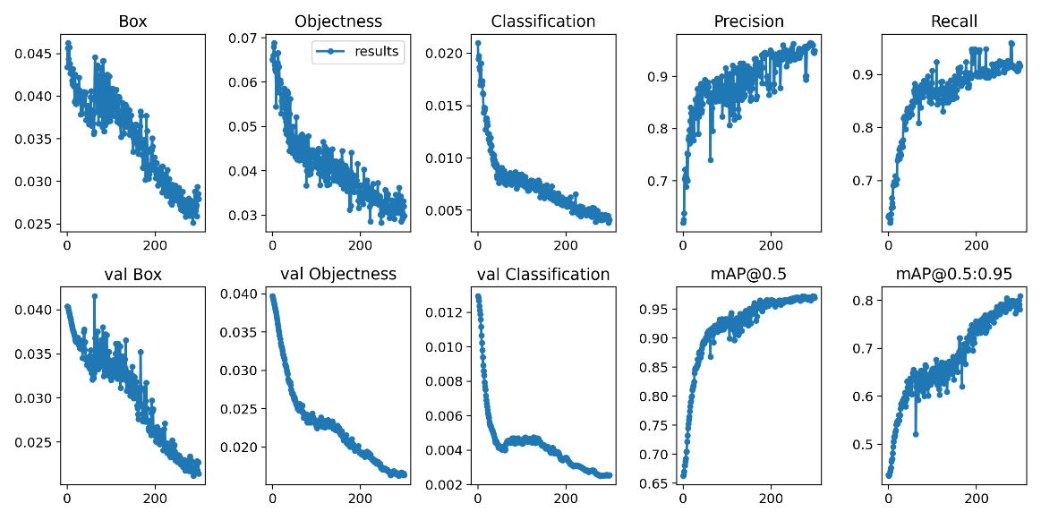
15- yolov5 - You can also plot any results.txt file manually:
from utils.plots import plot_results
plot_results(save_dir='runs/train/exp') # plot all results*.txt files in 'runs/train/exp'
Image(filename='runs/train/exp/results.png', width=800)

Slide 20
16- status
If this badge is green, all YOLOv5 GitHub Actions Continuous Integration (CI) tests are currently passing. CI tests verify correct operation of YOLOv5 training (train.py), testing (val.py), inference (detect.py) and export (export.py) on MacOS, Windows, and Ubuntu every 24 hours and on every commit.

Slide 21
17- yolov5
Appendix¶
Optional extras below. Unit tests validate repo functionality and should be run on any PRs submitted.
# Reproduce
for x in 'yolov5s', 'yolov5m', 'yolov5l', 'yolov5x':
!python val.py --weights {x}.pt --data coco.yaml --img 640 --conf 0.25 --iou 0.45 # speed
!python val.py --weights {x}.pt --data coco.yaml --img 640 --conf 0.001 --iou 0.65 # mAP
# PyTorch Hub
import torch
# Model
model = torch.hub.load('ultralytics/yolov5', 'yolov5s')
# Images
dir = 'https://ultralytics.com/images/'
imgs = [dir + f for f in ('zidane.jpg', 'bus.jpg')] # batch of images
# Inference
results = model(imgs)
results.print() # or .show(), .save()

Slide 22
18- yolov5
Unit tests
%%shell
export PYTHONPATH="$PWD" # to run *.py. files in subdirectories
rm -rf runs # remove runs/
for m in yolov5s; do # models
python train.py --weights $m.pt --epochs 3 --img 320 --device 0 # train pretrained
python train.py --weights '' --cfg $m.yaml --epochs 3 --img 320 --device 0 # train scratch
for d in 0 cpu; do # devices
python detect.py --weights $m.pt --device $d # detect official
python detect.py --weights runs/train/exp/weights/best.pt --device $d # detect custom
python val.py --weights $m.pt --device $d # val official
python val.py --weights runs/train/exp/weights/best.pt --device $d # val custom
done
python hubconf.py # hub
python models/yolo.py --cfg $m.yaml # inspect
python export.py --weights $m.pt --img 640 --batch 1 # export
done

Slide 23
19- yolov5
# Profile
from utils.torch_utils import profile
m1 = lambda x: x * torch.sigmoid(x)
m2 = torch.nn.SiLU()
profile(x=torch.randn(16, 3, 640, 640), ops=[m1, m2], n=100)
# Evolve
!python train.py --img 640 --batch 64 --epochs 100 --data coco128.yaml --weights yolov5s.pt --cache --noautoanchor --evolve
!d=runs/train/evolve && cp evolve.* $d && zip -r evolve.zip $d && gsutil mv evolve.zip gs://bucket # upload results (optional)
# VOC
for b, m in zip([64, 48, 32, 16], ['yolov5s', 'yolov5m', 'yolov5l', 'yolov5x']): # zip(batch_size, model)
!python train.py --batch {b} --weights {m}.pt --data VOC.yaml --epochs 50 --cache --img 512 --nosave --hyp hyp.finetune.yaml --project VOC --name {m}

Slide 24
20 # Introduction
This directory contains software developed by Ultralytics LLC, and **is freely available for redistribution under the GPL-3.0 license**. For more information please visit https://www.ultralytics.com.
# Description
The https://github.com/ultralytics/COCO2YOLO repo contains code to convert JSON datasets into YOLO (darknet) format. The code works on Linux, MacOS and Windows.
# Requirements
Python 3.7 or later with the following `pip3 install -U -r requirements.txt` packages:
- `numpy`
- `tqdm`
# Citation
[![DOI](https://zenodo.org/badge/186122711.svg)](https://zenodo.org/badge/latestdoi/186122711)
# Contact
Issues should be raised directly in the repository. For additional questions or comments please email Glenn Jocher at glenn.jocher@ultralytics.com or visit us at https://contact.ultralytics.com.

Slide 25
Concurso Kaggle
ejercicio (paso a paso)
https://www.kaggle.com/claudiorparrinello/siim-covid-19-yolo-v5-image-level-predictions/

Slide 26
1- paso1
1
#creating new directory
%cd ../
!mkdir siim_covid19
# Reason for creating & moving into this directory can be seen in above folder structure
%cd siim_covid19
!git clone https://github.com/ultralytics/yolov5 # clone repo
%cd yolov5
!pip install -r requirements.txt
# moving back to working directory
%cd ../

Slide 27
2- Salvando logs en W&B paso2
2
##------------------
#Not saving logs into W&B
##------------------
# Access WANDB account
#!pip install -q --upgrade wandb
#import wandb
#wandb.login()

Slide 28
3- Copiando yolov5 e instalando ( # pip install -r requirements.txt)
# pip install -r requirements.txt
# base ----------------------------------------
matplotlib>=3.2.2
numpy>=1.18.5
opencv-python>=4.1.2
Pillow
PyYAML>=5.3.1
scipy>=1.4.1
torch>=1.7.0
torchvision>=0.8.1
tqdm>=4.41.0
# logging -------------------------------------
tensorboard>=2.4.1
# wandb
# plotting ------------------------------------
seaborn>=0.11.0
pandas
# export --------------------------------------
# coremltools>=4.1
# onnx>=1.9.0
# scikit-learn==0.19.2 # for coreml quantization
# extras --------------------------------------
# Cython # for pycocotools https://github.com/cocodataset/cocoapi/issues/172
# pycocotools>=2.0 # COCO mAP
# albumentations>=1.0.3
thop # FLOPs computation
© 2021 GitHub, Inc.

Slide 29
4- Copiando modelos yolov5
4
Inference with YOLOv5 and PyTorch Hub. Models automatically download from the latest YOLOv5 release.
https://github.com/ultralytics/yolov5/releases
# Model
model = torch.hub.load('ultralytics/yolov5', 'yolov5s') # or yolov5m, yolov5l, yolov5x, custom
# Images
img = 'https://ultralytics.com/images/zidane.jpg' # or PosixPath, PIL, OpenCV, numpy, list
# Inference
results = model(img)
# Results
results.print() # or .show(), .save(), .crop(), .pandas(), etc.

Slide 30
5- Copiando yolov5 - Pretrained Checkpoints
Model | size ^{(pixels)} | mAP^{val} ^{0.5:0.95} | mAP^{test} ^{0.5:0.95} | mAP^{val} ^{0.5} | Speed ^{V100 (ms)} |  | params ^{(M)} | FLOPS ^{640 (B)}
YOLOv5s | 640 | 36.7 | 36.7 | 55.4 | 2.0 |  | 7.3 | 17.0
YOLOv5m | 640 | 44.5 | 44.5 | 63.1 | 2.7 |  | 21.4 | 51.3
YOLOv5l | 640 | 48.2 | 48.2 | 66.9 | 3.8 |  | 47.0 | 115.4
YOLOv5x | 640 | 50.4 | 50.4 | 68.8 | 6.1 |  | 87.7 | 218.8
YOLOv5s6 | 1280 | 43.3 | 43.3 | 61.9 | 4.3 |  | 12.7 | 17.4
YOLOv5m6 | 1280 | 50.5 | 50.5 | 68.7 | 8.4 |  | 35.9 | 52.4
YOLOv5l6 | 1280 | 53.4 | 53.4 | 71.1 | 12.3 |  | 77.2 | 117.7
YOLOv5x6 | 1280 | 54.4 | 54.4 | 72.0 | 22.4 |  | 141.8 | 222.9
YOLOv5x6 TTA | 1280 | 55.0 | 55.0 | 72.0 | 70.8 |  | -

Slide 31
6- Inference with detect.py
6
detect.py runs inference on a variety of sources, downloading models automatically from the latest YOLOv5 release and saving results to runs/detect.
$ python detect.py --source 0 # webcam
file.jpg # image
file.mp4 # video
path/ # directory
path/*.jpg # glob
'https://youtu.be/NUsoVlDFqZg' # YouTube video
'rtsp://example.com/media.mp4' # RTSP, RTMP, HTTP stream

Slide 32
Importing Dependencies
import os
import shutil
import tensorflow as tf
import yaml
import numpy as np
import pandas as pd
from sklearn.model_selection import train_test_split
import ast
import matplotlib.pyplot as plt
import cv2
import PIL
import warnings
warnings.filterwarnings('ignore')

Slide 33
Importing Dependencies
TRAIN_PATH = "../input/siim-covid19-dataset-256px-jpg/512px/train/train/"
HEIGHT,WIDTH = 512,512
CHANNELS = 3
BATCH_SIZE = 16
EPOCHS = 40
SEED =2021

Slide 34
CSV file
# Get image path from image_id
def get_path(image_id):
path = tf.io.gfile.glob(TRAIN_PATH + f"*{image_id}.jpg")[0]
return path
image_dict = {
"opacity" : 1,
"none" : 0
}
df = pd.read_csv("../input/siim-covid19-dataset-256px-jpg/train.csv")
df["image_label"] = df["image_label"].map(lambda x : x.split(" ")[0])
df["image_label_id"] = df["image_label"].map(lambda x : image_dict[x])
df["filepath"] = df["ImageInstanceUID"].map(get_path)
df.head(3)

Slide 35
Splitting Data
train_df,val_df = train_test_split(df,
test_size=0.2,
random_state = SEED,
stratify = df.image_label.values
)
train_df.loc[:,"data"] = "train"
val_df.loc[:,"data"] = "val"
df = pd.concat([train_df, val_df]).reset_index(drop=True)

Slide 36
Preparing folder structure
os.makedirs('../siim_covid19/dataset/images/train', exist_ok=True)
os.makedirs('../siim_covid19/dataset/images/val', exist_ok=True)
os.makedirs('../siim_covid19/dataset/labels/train', exist_ok=True)
os.makedirs('../siim_covid19/dataset/labels/val', exist_ok=True)
print("Created folder structure")
IMAGE_PATH = "../siim_covid19/dataset/images"
for i in df.values:
data = i[10]
img_name = i[9].split("/")[-1]
shutil.copyfile(i[9],f"{IMAGE_PATH}/{data}/{img_name}")

Slide 37
Creating YAML file
# REF : https://www.kaggle.com/ayuraj/train-covid-19-detection-using-yolov5
yaml_dict = dict(
train = "../dataset/images/train",
val = "../dataset/images/val",
nc = 2,
names = ["none","opacity"]
)
with open("../siim_covid19/yolov5/data/data.yaml", "w") as f:
yaml.dump(yaml_dict,f,default_flow_style=True)

Slide 38
Preprocessing Bounding Boxes
df["boxes"] = df["boxes"].map(lambda x : ast.literal_eval(x))
def preprocess_bbox(row):
factor_x = 1/row[5]
factor_y = 1/row[4]
bboxes = []
if row[7] == "opacity":
for box in row[6]:
x = box["x"]*factor_x
y = box["y"]*factor_y
w = box["width"]*factor_x
h = box["height"]*factor_y
xc = x + w/2
yc = y + h/2
bboxes.append([xc,yc,w,h])
return bboxes

Slide 39
Preprocessing Bounding Boxes
# Prepare txt files
LABEL_PATH = "../siim_covid19/dataset/labels"
for row in df.values:
filename = row[9].split("/")[-1][:-4]
filepath = f"{LABEL_PATH}/{row[10]}/{filename}.txt"
if row[7] == "opacity":
bbox = preprocess_bbox(row)
with open(filepath, "w") as f:
for box in bbox:
box = [1] + box
box = [str(i) for i in box]
box = ' '.join(box)
f.write(box)
f.write('\n')

Slide 40
Training
%cd yolov5/
!wandb off
!python train.py --img {HEIGHT} \
--batch {BATCH_SIZE} \
--epochs {EPOCHS} \
--data data.yaml \
--weights yolov5s.pt \
--save_period 1\
--name yolov5_training
%cd ../../
train_ls = tf.io.gfile.glob("./siim_covid19/yolov5/runs/train/yolov5_training/*.*g")
os.makedirs("./working/train_results", exist_ok=True)
for filepath in train_ls:
name = filepath.split("/")[-1]
shutil.copyfile(filepath,"./working/train_results/"+name)
shutil.copyfile("./siim_covid19/yolov5/runs/train/yolov5_training/weights/best.pt","./working/best_yolov5.pt")
print("Training curves moved to output directory")
print("Training Completed")

Slide 41
Inference
TEST_PATH = "/kaggle/input/siim-covid19-dataset-256px-jpg/224px/test/test"
BEST_MODEL_PATH ="./runs/train/yolov5_training/weights/best.pt"
%cd ./siim_covid19/yolov5
!python detect.py --weights {BEST_MODEL_PATH} \
--source {TEST_PATH} \
--img {HEIGHT} \
--conf 0.3 \
--iou-thres 0.5 \
--max-det 3 \
--save-txt \
--save-conf \
--name yolov5_testing
print("Predictions Completed")

Slide 42
Format of txt file of output
label_id x_center y_center width height

Slide 43
Sample Prediction
PREDICTIONS_PATH = "runs/detect/yolov5_testing/labels/"
PRED_FILES = os.listdir(PREDICTIONS_PATH)
print("Sample prediction (in txt file) : \n")
with open(PREDICTIONS_PATH + PRED_FILES[0], "r") as f:
ls = f.read().strip("\n").split(" ")
print(f"LABEL : {ls[0]} \nX_CENTER : {ls[1]} \nY_CENTER : {ls[2]} \nWIDTH : {ls[3]} \nHEIGHT : {ls[4]} \nCONFIDENCE : {ls[5]}")
print("Number of Prediction file originally present : ",len(PRED_FILES))

Slide 44
Creating txt files for "none" class
IMAGE_FILES = tf.io.gfile.glob("runs/detect/yolov5_testing/*.jpg")
ACTUAL_FILES = []
for path in IMAGE_FILES:
ls = path.split("/")
name = ls[-1].split(".")[0] + ".txt"
ACTUAL_FILES.append(PREDICTIONS_PATH + name)
for filepath in ACTUAL_FILES:
if not os.path.exists(filepath):
with open(filepath,"w") as f:
f.write("0 0 0 1 1 1")
f.close()

Slide 45
Preprocessing functions
##------------------------------------------
#getting string of predictions from txt file
##------------------------------------------
def get_string(filepath,out= "bbox"):
probs = []
bboxes = []
labels = []
with open(filepath, "r") as f:
for line in f:
ls = line.strip("\n").split(" ")
ls = list(map(float, ls))
labels.append(ls[0])
bboxes.append(ls[1:-1])
probs.append(ls[-1])
if out == "bbox":
return bboxes
elif out == "label":
return labels
else:
return probs
​
##------------------------------------------
#Scaling-up bounding box co-ordinates
##------------------------------------------
def scale_bbox(row):
scale_x = row[5]
scale_y = row[6]
scale_bboxes = []
for box in row[1]:
if row[2][0] != 0.0:
xc,yc = box[0]*scale_x,box[1]*scale_y
w,h = box[2]*scale_x,box[3]*scale_y
xmin,ymin = int(xc - w/2),int(yc - h/2)
xmax,ymax = int(xc + w/2),int(yc + h/2)
scale_bboxes.append([xmin,ymin,xmax,ymax])
else:
return [[0,0,1,1]]
return scale_bboxes

Slide 46
Preprocessing prediction csv file
pred_df = pd.DataFrame.from_dict({"filepath" : ACTUAL_FILES})
pred_df["bboxes"] = pred_df["filepath"].map(lambda x: get_string(x,out="bbox"))
pred_df["label"] = pred_df["filepath"].map(lambda x: get_string(x,out="label"))
pred_df["confidence"] = pred_df["filepath"].map(lambda x: get_string(x,out="conf"))
pred_df["ImageInstanceUID"] = pred_df["filepath"].map(lambda x : x.split("/")[-1].split("_")[-1][:-4])
#%cd ../
meta_df = pd.read_csv("/kaggle/input/siim-covid19-dataset-256px-jpg/meta_test.csv")
pred_df = pred_df.merge(meta_df, on = "ImageInstanceUID")
box_ls = []
for i,row in enumerate(pred_df.values):
box_ls.append(scale_bbox(row))
pred_df["scale_bboxes"] = box_ls
pred_df.head(3)
Final Study Level Predictions

Slide 47
Final Study Level Predictions
%cd ../../../
image_dict = {
0. : "none",
1. : "opacity"
}
def get_string(row):
string = ""
if row[2][0] == 0.:
string += "none 1 0 0 1 1"
return string
for i in range(len(row[2])):
string += "opacity "
string += str(row[3][i])
string += " "
bbox = map(str,row[7][i])
tmp = " ".join(bbox)
string += tmp
string += " "
return string
strings = []
for row in pred_df.values:
strings.append(get_string(row))
test_df = pd.DataFrame.from_dict({"Id" : pred_df["ImageInstanceUID"]})
test_df["Id"] = test_df['Id'].map(lambda x : x+"_image")
test_df["PredictionString"] = strings
test_df.to_csv("kaggle/working/study_level_pred.csv",index = False)
test_df.head()

Slide 48
Preprocessing prediction csv file

Slide 49
Información yolov5

Slide 50
GENERALES 1
If this badge is green, all YOLOv5 GitHub Actions Continuous Integration (CI) tests are currently passing. CI tests verify correct operation of YOLOv5 training (train.py), validation (val.py), inference (detect.py) and export (export.py) on MacOS, Windows, and Ubuntu every 24 hours and on every commit.
https://towardsdatascience.com/yolo-v5-object-detection-tutorial-2e607b9013ef
https://jooskorstanje.com/yolov5-training-a-custom-object-detection-model.html

